Slide 1


Ramiro Asturias
March 21st 2022

Slide 2

Outline
Executive Summary
Introduction
Methodology
Results
Conclusion
Appendix

Slide 3
Executive Summary
Summary of methodologies
Collected and cleaned data from SpaceX API and HTML Table from Wikipedia
Exploratory Data Analysis (EDA) to find patterns in the data and determine what would be the label for training supervised models' outcomes of the landings that our model will be predicting
EDA with visualizations and Feature Engineering
Built interactive Maps to visualize landings and interactive Dashboards to validate correlations
Perform exploratory Data Analysis and determine Training Labels
Create a column for the class
Standardize the data
Split into training data and test data
Test best model for prediction with best parameters based on training data
Summary of all results
Interactive and predictive analysis
Based on models' performance Decision Tree and KNN models with 88% accuracy are the best

Slide 4
Introduction
SpaceX, a company that is thriving by making space travel affordable for everyone because their rocket launches are relatively inexpensive.
SpaceX advertises Falcon 9 rocket launches on its website with a cost of 62 million dollars;
other providers cost upwards of 165 million dollars each, much of the savings is because
SpaceX can reuse the first stage.
Space Y that would like to compete with SpaceX founded by Billionaire industrialist Allon
Musk.
We want determine the price of each launch by gathering information about Space X and creating dashboards for Space Y.
We will also determine if SpaceX will reuse the first stage.
Instead of using rocket science to determine if the first stage will land successfully, we will train a machine learning model and use public information to predict if SpaceX will reuse the first stage.

Slide 5

Section 1

Slide 6
Methodology
Executive Summary
Data collection methodology:
SpaceX Rest API for rocket, launch platform, payloads and core information
Web Scrapping from Wikipedia for launch historical records
Perform data wrangling
Created an outcome label “class” to determine the result of the launch ( 0 fail, 1 success) based on the landing outcome calculated column
Perform exploratory data analysis (EDA) using visualization and SQL
Perform interactive visual analytics using Folium and Plotly Dash
Perform predictive analysis using classification models
Created column for class, standardize data, split into training and test data. Found the best Hyperparameter for SVM, CT, LR and then compare their scores.

Slide 7
Data Collection
Describe how data sets were collected.
SpaceX API was collected using requests library and helper functions to extract information from the responses
HTML Wikipedia page data was collected with BeautifulSoup library
SpaceX API
Wikipedia Page
Call SpaceX API url
Decode response as Json into dataframe
Use multiple API calls to complete the information
Filter dataframe to capture Falcon 9 data
Perform Data wrangling to complete missing info
Save CSV
Loaded HTML page
Parsed HTML to extract relevant data
Created dataframe with parsed HTML data
Save CSV
Loaded response on Beautiful object

Slide 8
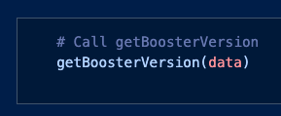
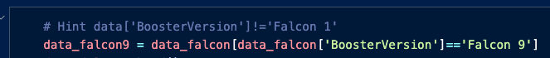
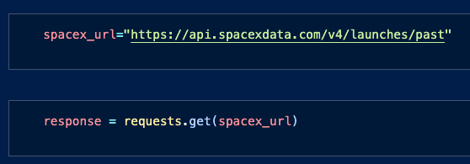
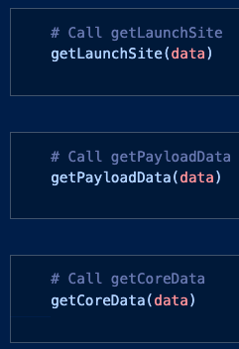
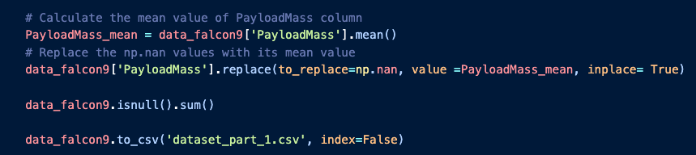
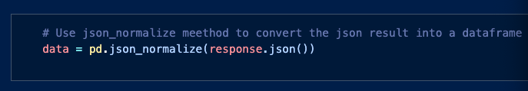
Call SpaceX API url
Decode response as Json into dataframe
Use multiple API calls to complete the information
Filter dataframe to capture Falcon 9 data
Perform Data wrangling to complete missing info
Save CSV
Data Collection – SpaceX API
Request Data
Notebook URL
Result Data URL

Slide 9
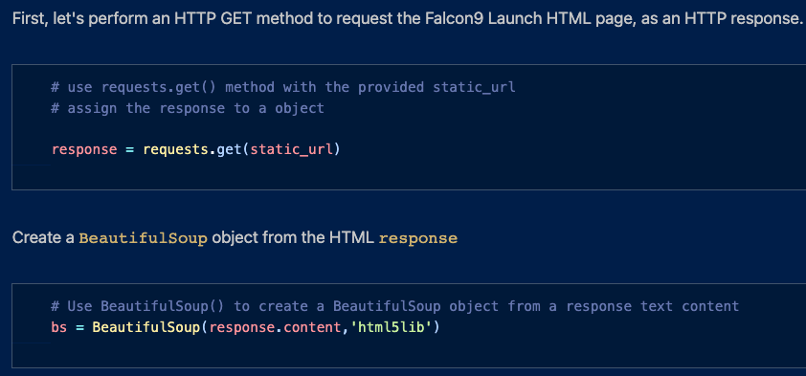
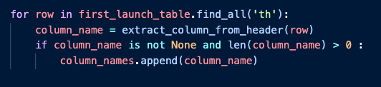
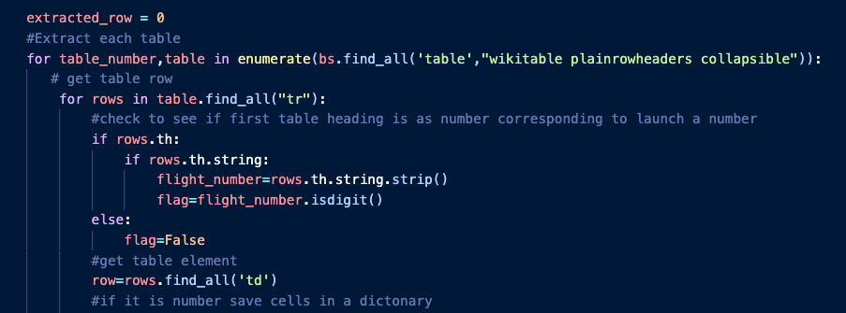
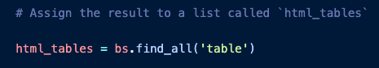
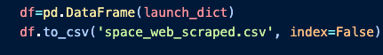
Loaded HTML page
Parsed HTML to extract relevant data
Created dataframe with parsed HTML data
Save CSV
Loaded response on Beautiful object
Data Collection - Scraping
Notebook URL
Result Data URL

Slide 10
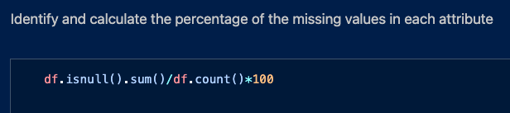
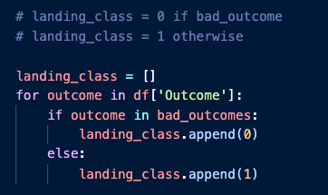
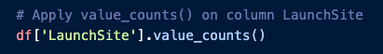
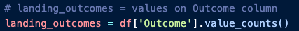
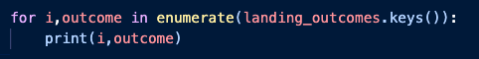
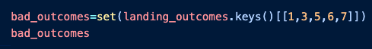
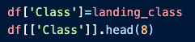
Identify missing values
Identify categorical Vs numerical columns
Calculate the number of launches for each site
calculate the occurrence of each orbit
Determine the number and occurrence of mission outcomes
Create landing label from outcome column
Create class column representing outcome of landing
Save CSV
Data Wrangling
Notebook URL
Result Data URL

Slide 11
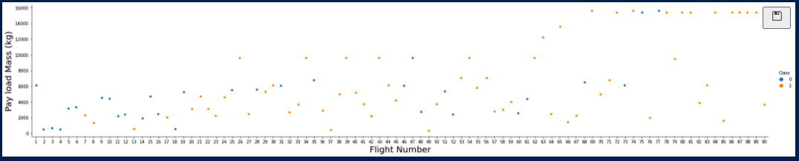
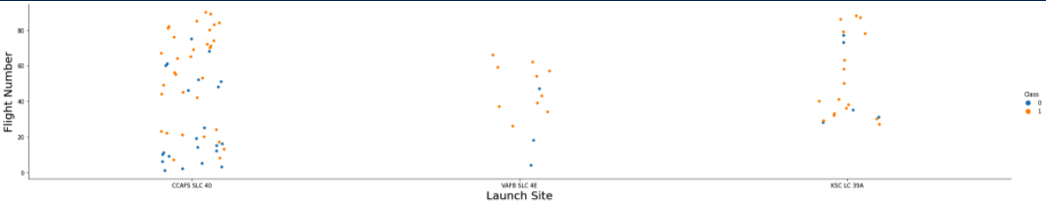
EDA with Data Visualization
We see that as the flight number increases, the first stage is more likely to land successfully.
The payload mass is also important; it seems the more massive the payload, the less likely the first stage will return
Relationship between Flight Number and Launch Site
Notebook URL

Slide 12
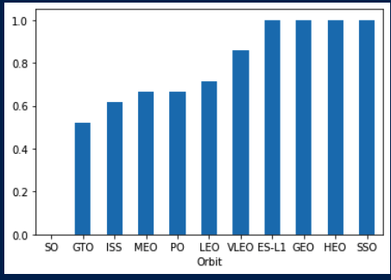
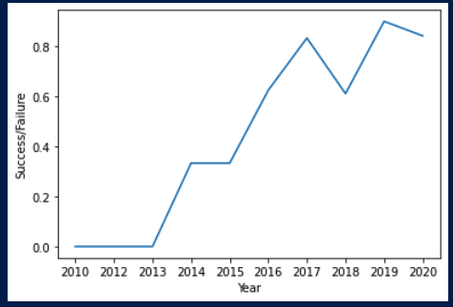
EDA with Data Visualization
Relationship Success Rate based on Orbit
The average of success increases as the years go by
Notebook URL

Slide 13
EDA with SQL
Display the names of the unique launch sites in the space mission
Display 5 records where launch sites begin with the string 'CCA'
Display the total payload mass carried by boosters launched by NASA (CRS)
Display average payload mass carried by booster version F9 v1.1
List the date when the first successful landing outcome in ground pad was achieved.
List the names of the boosters which have success in drone ship and have payload mass greater than 4000 but less than 6000
List the total number of successful and failure mission outcomes
List the names of the booster_versions which have carried the maximum payload mass. Use a subquery
List the failed landing_outcomes in drone ship, their booster versions, and launch site names for in year 2015
Rank the count of landing outcomes (such as Failure (drone ship) or Success (ground pad)) between the date 2010-06-04 and 2017-03-20, in descending order
Notebook URL

Slide 14
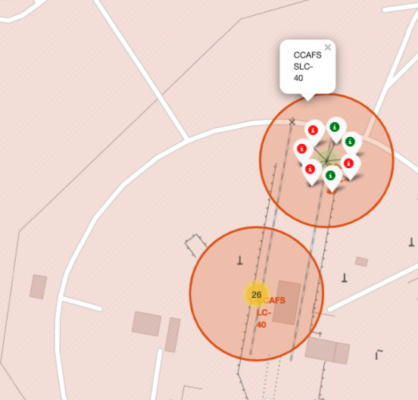
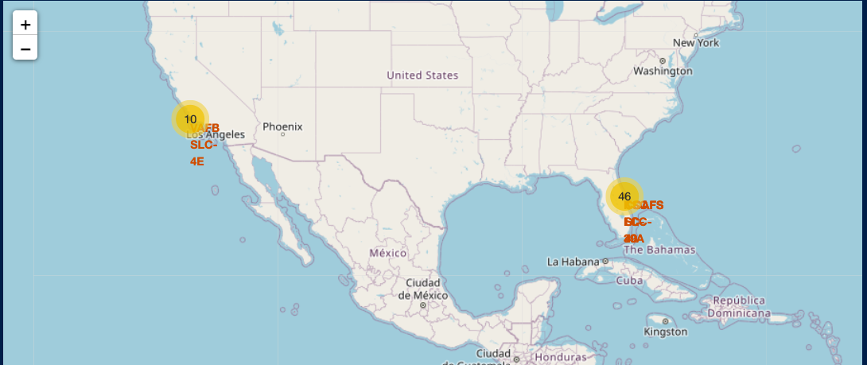
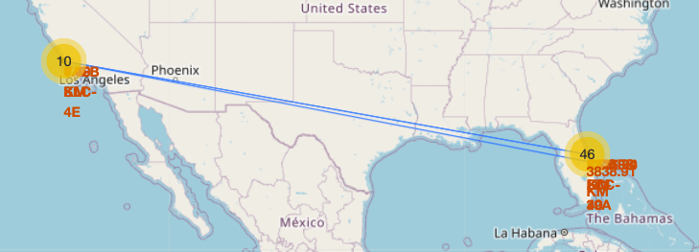
Build an Interactive Map with Folium
Created circle markers for launch site on the map
Marked the success/failed launches for each site on the map grouped or in clusters
Used Lines to calculate distance between launch sites
Notebook URL

Slide 15
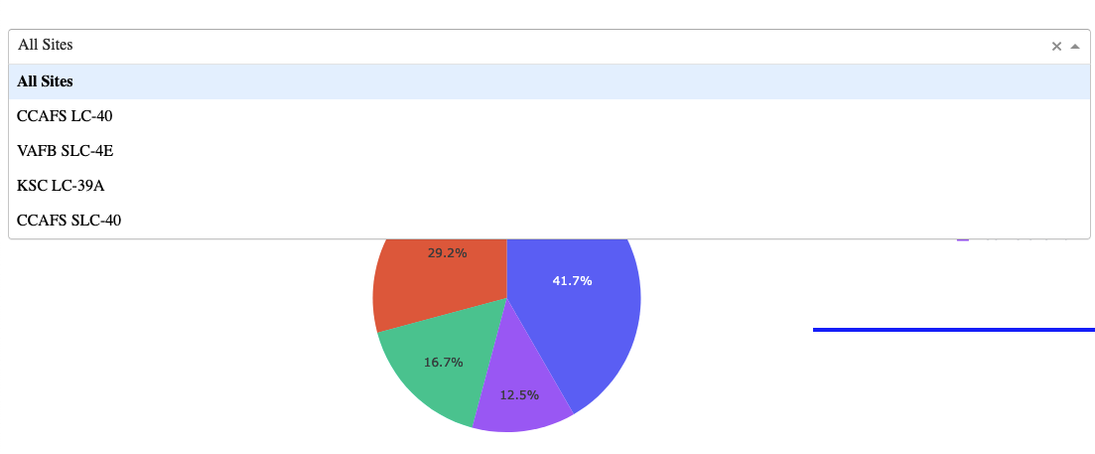
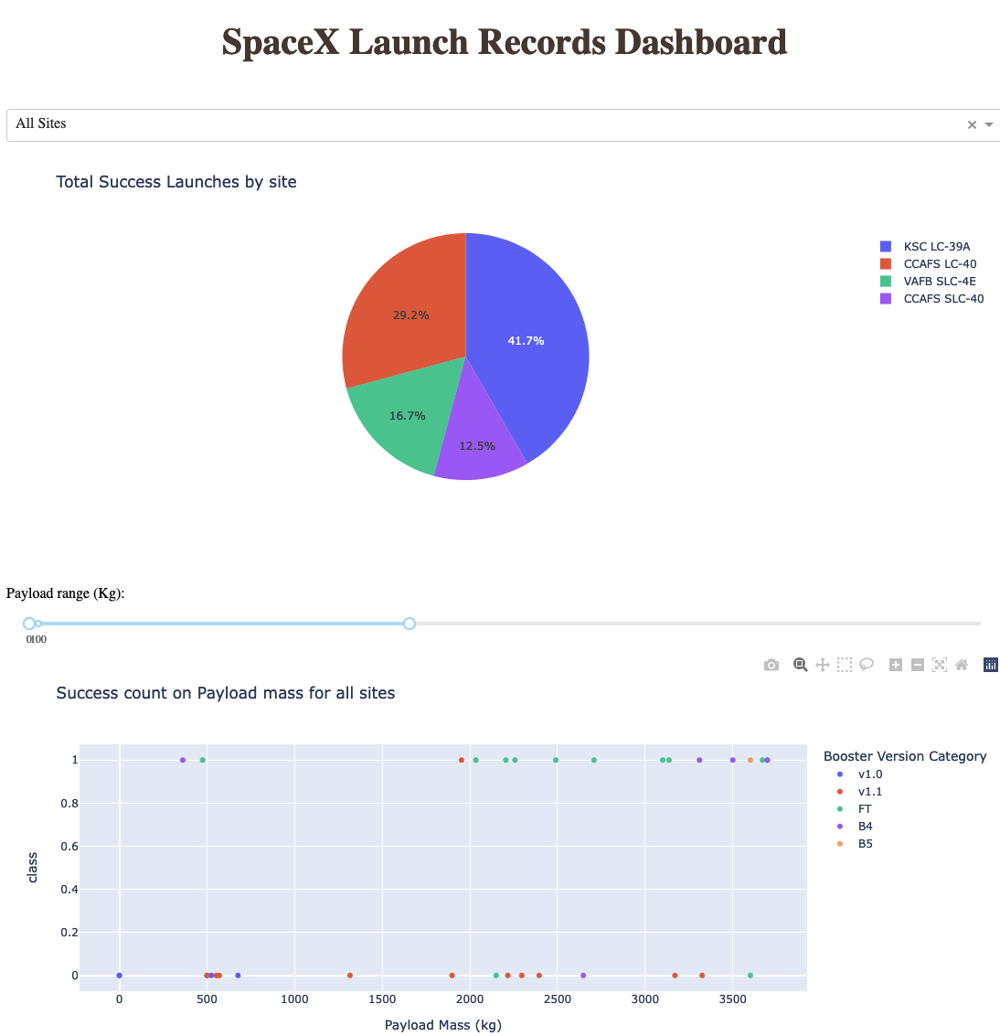
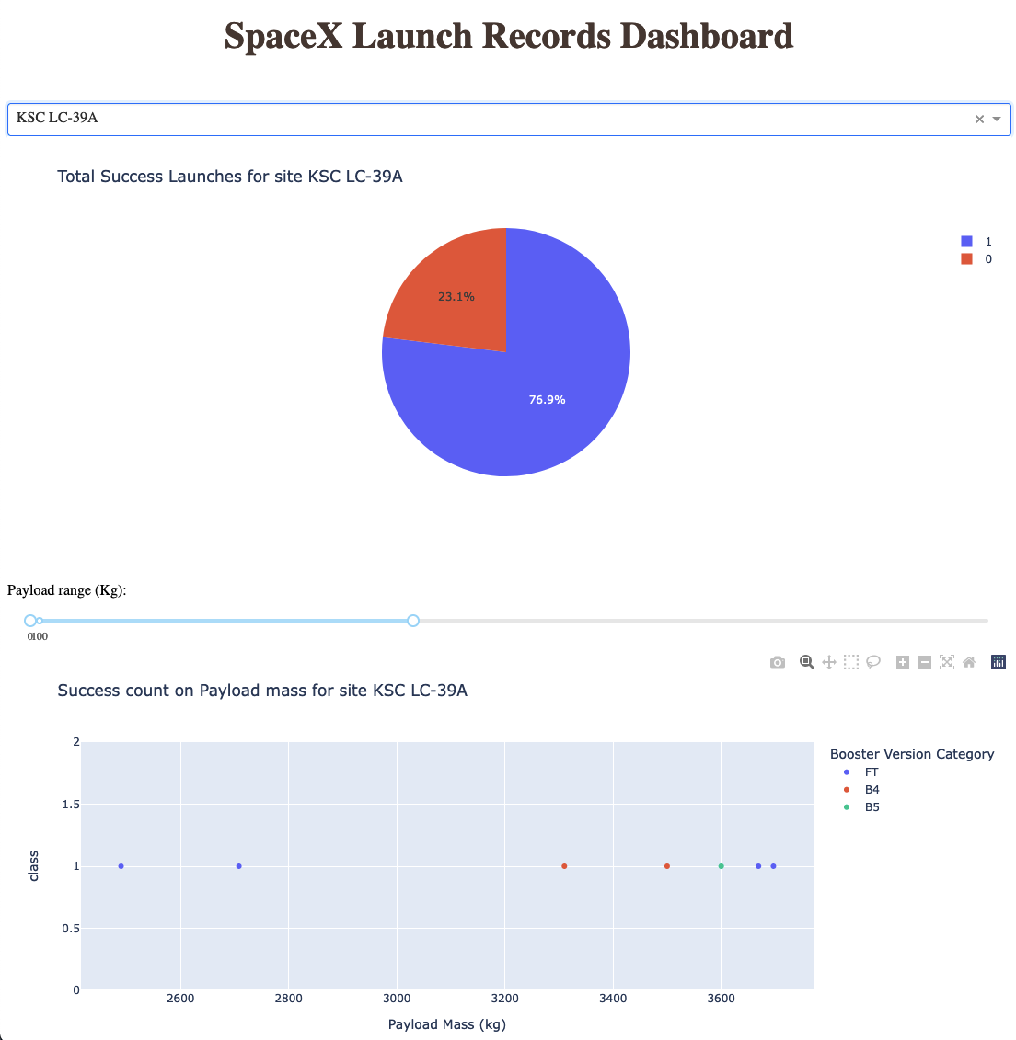
Build a Dashboard with Plotly Dash
Filter for all launching sites to see outcomes
Success count based on Payload mass
Notebook URL

Slide 16
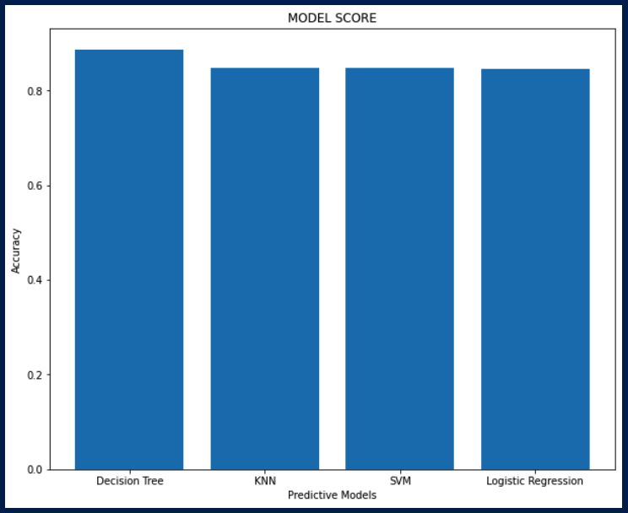
Predictive Analysis (Classification)
With the dataframe containing all data created a predicted variable Y with the class variable
Standardized the independent variables X
Separated the train dataset and the test with train_test_split function
Used GridSearchCV with the configuration parameters for each of the models to find the best independent variables configurations
Created a confusion matrix for each method to tabulate their performance
The best model with the Hyperparameters is GT with 90% accuracy
Perform EDA to determine Training Labels
Find best Hyperparameter for SVM, Classification Trees and Logistic Regression
Find the method performs best using test data
Notebook URL

Slide 17
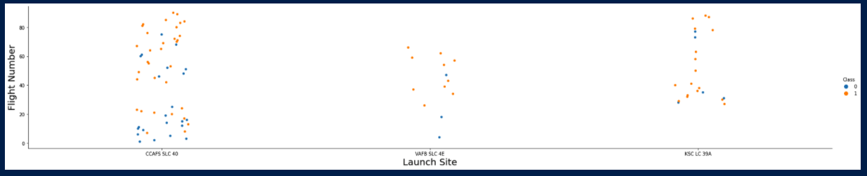
Results
Exploratory data analysis results
Relationship between Flight Number and Launch Site
We see that different launch sites have different success rates. CCAFS LC-40, has a success rate of 60% which seems lower compared to the other sites. But has almost 2 times more launches in comparation

Slide 18
Results
Interactive analytics
We can observe that as the payload increases the success on every site improves as well Specially for booster FT
Booster V1.1 is a good indicator for all spaces that regardless the payload mass it will not return

Slide 19
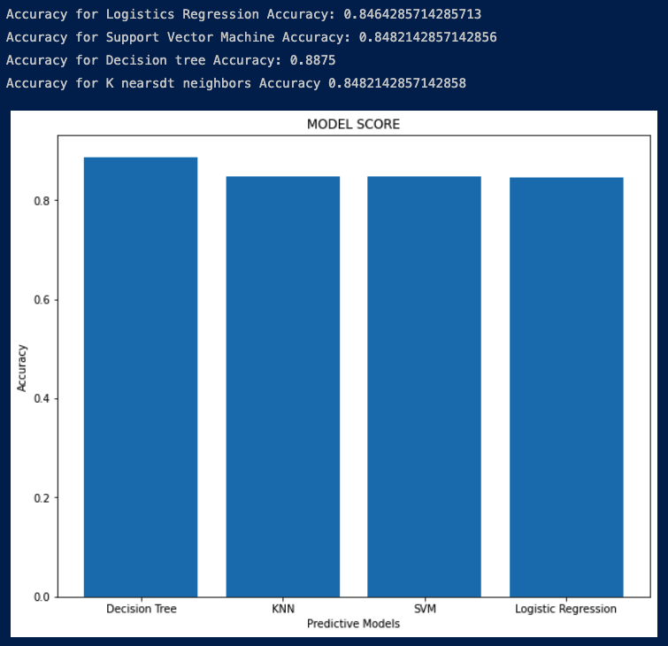
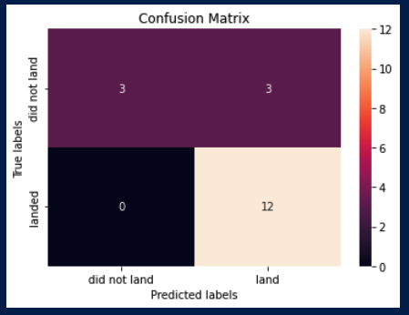
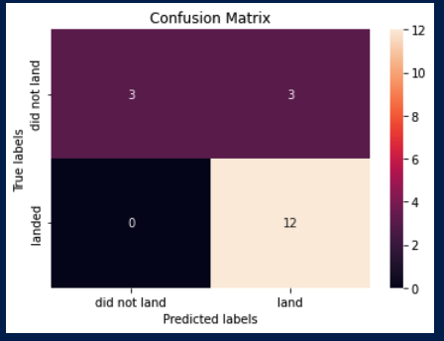
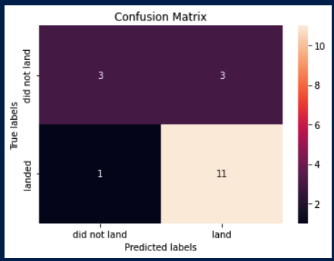
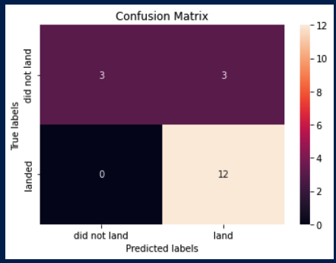
Results
Predictive analysis results
SVM
Logarithm Regression
Decision Tree
KNN

Slide 20

Section 2

Slide 21
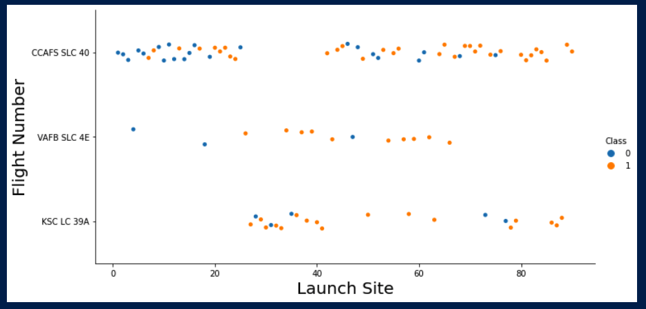
Flight Number vs. Launch Site
Launches from CCAFS SLC are higher.
VAFB is relatively consistent on success launches

Slide 22
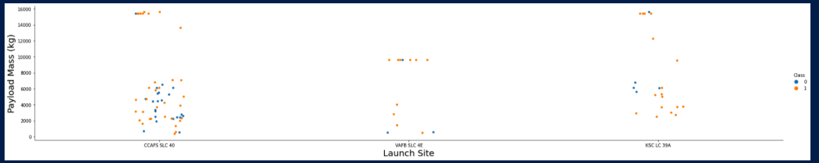
Payload vs. Launch Site
For the VAFB-SLC launch site there are no rockets launched for heavy payload mass(greater than 10000)
The greater the payload the more likely Phase 1 will return

Slide 23
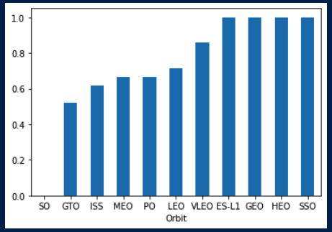
Success Rate vs. Orbit Type
GEO HEO and SSO are the most successful orbits to launch

Slide 24
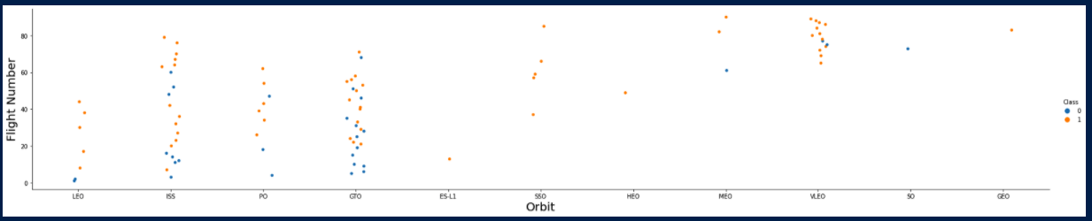
Flight Number vs. Orbit Type
LEO orbit the Success appears related to the number of flights; on the other hand, there seems to be no relationship between flight number when in GTO orbit.

Slide 25
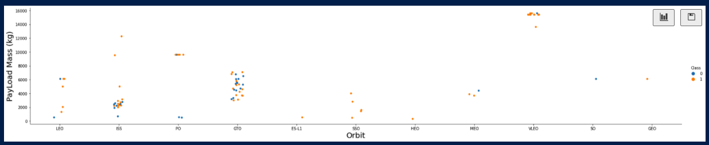
Payload vs. Orbit Type
With heavy payloads the successful landing or positive landing rate are more for Polar,LEO and ISS. However for GTO we cannot distinguish this well as both positive landing rate and negative landing(unsuccessful mission) are both there here.

Slide 26
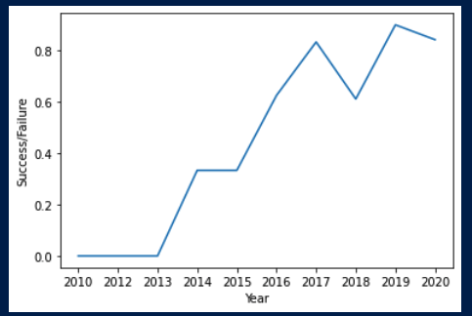
Launch Success Yearly Trend
As time passes the success rate has proportionally increased

Slide 27
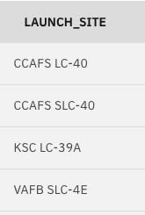
All Launch Site Names
Select distinct(LAUNCH_SITE) from SPACEXBTL

Slide 28
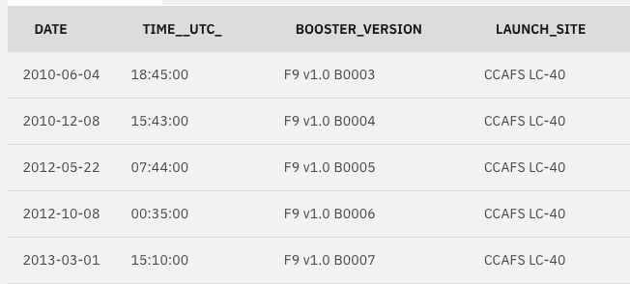
Launch Site Names Begin with 'CCA'
Select * from SPACEXTBL where LAUNCH_SITE like 'CCA%' limit 5;

Slide 29
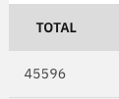
Total Payload Mass
Select sum(PAYLOAD_MASS__KG_) as total from SPACEXTBL where CUSTOMER = 'NASA (CRS)’;

Slide 30
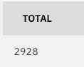
Average Payload Mass by F9 v1.1
Select avg(PAYLOAD_MASS__KG_) as total from SPACEXTBL where BOOSTER_VERSION = 'F9 v1.1';

Slide 31
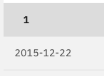
First Successful Ground Landing Date
select min(DATE) from SPACEXTBL where LANDING__OUTCOME like '%Success%';

Slide 32
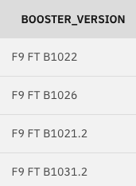
Successful Drone Ship Landing with Payload between 4000 and 6000
select BOOSTER_VERSION from SPACEXTBL where LANDING__OUTCOME = 'Success (drone ship)' and PAYLOAD_MASS__KG_ BETWEEN 4000 and 6000;

Slide 33
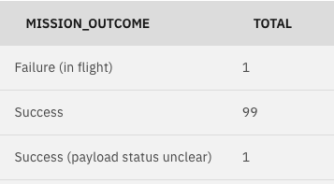
Total Number of Successful and Failure Mission Outcomes
select MISSION_OUTCOME, count(MISSION_OUTCOME) as total from SPACEXTBL GROUP BY MISSION_OUTCOME;

Slide 34
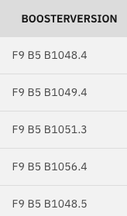
Boosters Carried Maximum Payload
select BOOSTER_VERSION as boosterversion from SPACEXTBL where PAYLOAD_MASS__KG_=(select max(PAYLOAD_MASS__KG_) from SPACEXTBL);

Slide 35
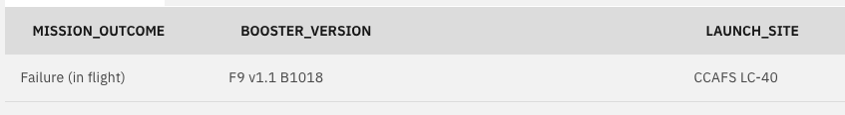
2015 Launch Records
SELECT MISSION_OUTCOME,BOOSTER_VERSION,LAUNCH_SITE FROM SPACEXTBL where EXTRACT(YEAR FROM DATE)='2015' and MISSION_OUTCOME != 'Success’;

Slide 36

Rank Landing Outcomes Between 2010-06-04 and 2017-03-20
select LANDING__OUTCOME, count(LANDING__OUTCOME) as total from SPACEXTBL where DATE BETWEEN '2010-06-04' AND '2017-03-20' GROUP BY LANDING__OUTCOME ORDER BY total desc;

Slide 37

Section 3

Slide 38

Launch Site Locations
All Launch sites are very close proximity to coasts to prevent any damage to private property or civilians in case of accident
Locations are as close to the Equator as possible.

Slide 39




Launch Locations Outcomes
CCAFS LC-40
VAFB SLC-4E
KSC LC-39A
Green marker indicates success and Red failure
KSC seems to be the most successful and CCAFS where most launches happen

Slide 40

Coast Line distance of 1.50 KM
VAFB-SLC4E– Coast Lines

Slide 41

Section 4

Slide 42

Launch success for all Sites
LC40 and LC39A have the largest proportion of success.

Slide 43

KSC LC 39 Launch Outcome overview
LC39A have the largest proportion of success from all sites but itself the success rate is not the best.

Slide 44

Success by LaunchSite based on Payload Mass
The lower the payload the better the chances to have success launches and returns..

Slide 45

Section 5

Slide 46
Classification Accuracy
The best model with the Hyperparameters is GT with 89% accuracy

Slide 47
Confusion Matrix
DT model has a very good performance on predicting Landing.
It has bad performance for predict no landing – 50% chance to get it correct. Additional training data could help to add more accuracy

Slide 48


Conclusions
Worth revisiting the model every year as the more time passes more likely success rockets
Booster and Payload mass are key indicators for success. FT booster is the best performer
The bigger the mass less chances for success

Slide 49
Appendix
Include any relevant assets like Python code snippets, SQL queries, charts, Notebook outputs, or data sets that you may have created during this project

Slide 50


